Slide 1

MSCI 311
Organizational Design and Technology
Instructor: Ayman Alzayat, aalzayat@uwaterloo.ca
TA: Varsha Suryanarayana, vsuryana@uwaterloo.ca

Slide 2
OVERVIEW
Fundamentals of organizational design.
Some overlap with chapter 6 in the textbook.

Slide 3
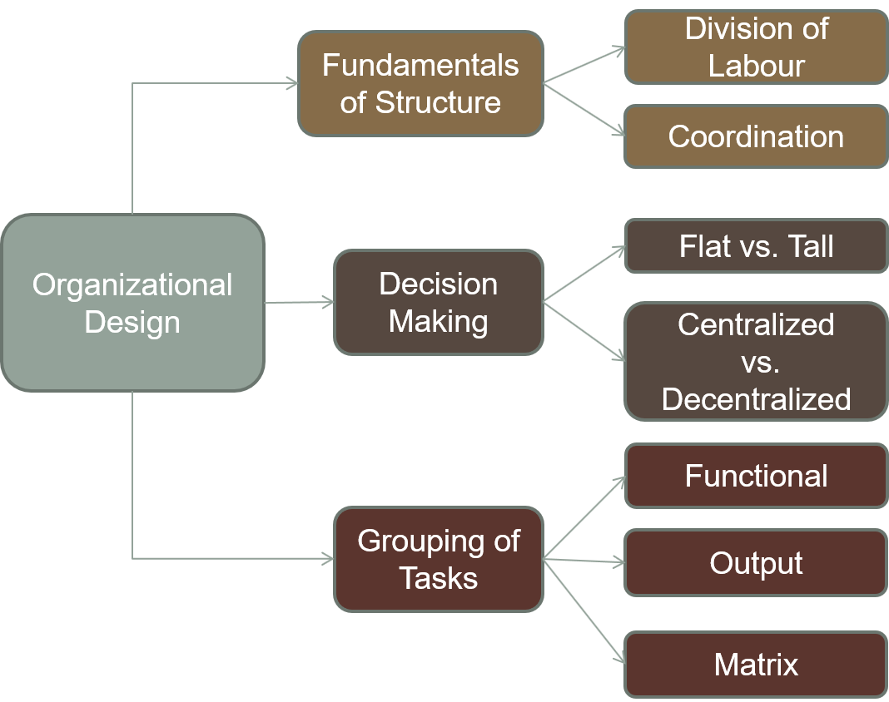
Fundamentals of Organizational Design

Slide 4
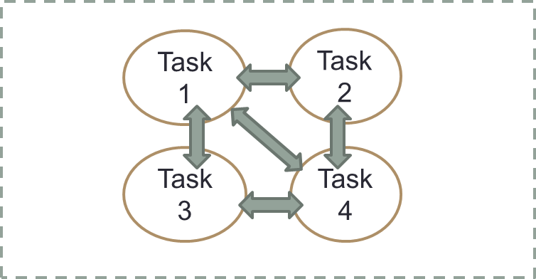
Introduction
“The structure of an organization can be defined simply as the sum total of the ways in which it divides its labour into distinct tasks and then achieves coordination among them”
Exercise: How is labour divided at a Tim Horton’s coffee shop? How is coordination achieved?
Organizational Structure

Slide 5
Design Variables
Division of labor (specialization)
The way in which labor is divided into distinct tasks
Example: Tim Hortons

Slide 6
Design Variables
Division of labor Advantages:
Expert performance
If the task is simple you can get very good at it
Reduced training time
The more you divide a task, the quicker it is to learn
Minimum dependence on labor
Workers are easily replaced

Slide 7
Design Variables
Division of labor Disadvantages:
The more you divide labor, the more difficult it is to achieve coordination
Example: Renovating a room, building a table.
Worker alienation
Example: Fast-food worker

Slide 8

Design Variables
Coordination
Recall definition of structure
Three components of coordination
Communication
Message gets from A to B. What is encoded by A is decoded by B.
Cooperation
There must be willingness to co-operate
Capacity
In addition to understanding what A is asking and being willing to help, B must also be able (have the capacity) to do so.

Slide 9
Design Variables
Five Coordinating Mechanisms
Mutual Adjustment
Direct Supervision
Standardization of Work Processes
Standardization of outputs
Standardization of skills
Mutual Adjustment
Direct Supervision
Standardization
Mutual Adjustment
Simple
Complex

Slide 10
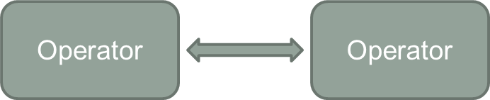
Five Coordinating Mechanisms
Mutual Adjustment
Informal communication (e.g. two people carrying a couch up the stairs)
A basic form of coordination

Slide 11


Five Coordinating Mechanisms
Direct Supervision
One takes responsibility for the work of many

Slide 12
Five Coordinating Mechanisms
Standardization
Coordination incorporated when job is designed
Standardization of work processes
Contents of work are specified, or programmed (i.e. the steps are specified)
Specific instructions on how to do something - reduces need for supervisor
Standardization of outputs
Results of the work are specified (e.g. dimensions of the product)
Specific instructions for what the output ought to look like
Standardization of skills
Training required to do the work is specified (e.g. doctor)

Slide 13
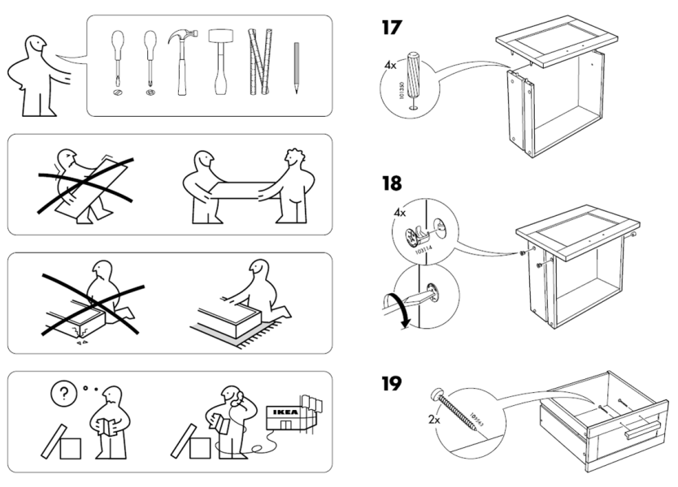
Standardization
When assembling IKEA furniture, the package comes with assembly instructions. Is this...
Standardization of output?
Standardization of work process?
Standardization of skill?
All of the above?

Slide 14
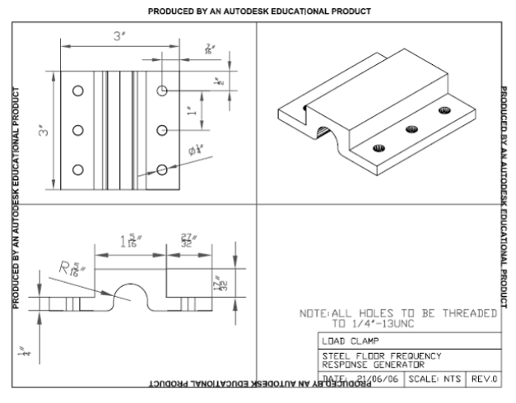
Standardization
This AutoCad drawing represents a…
Standardization of output?
Standardization of work process?
Standardization of skill?
All of the above?

Slide 15
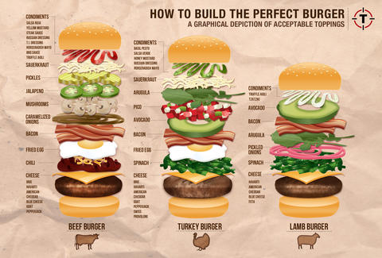
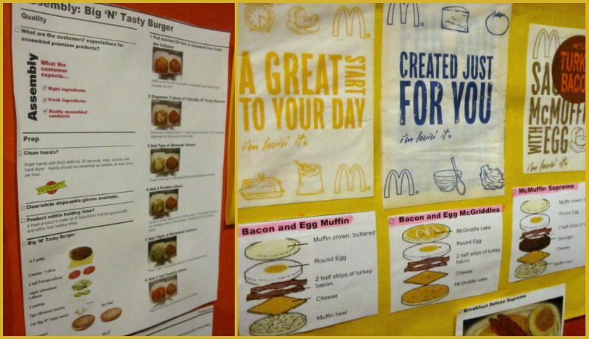
Standardization
McDonald’s burger assembly charts represent…
Standardization of output?
Standardization of work process?
Standardization of skill?
All of the above?

Slide 16

Standardization
A doctor that treats a patient, is an excellent example of...
Standardization of output?
Standardization of work process?
Standardization of skill?
All of the above?

Slide 17
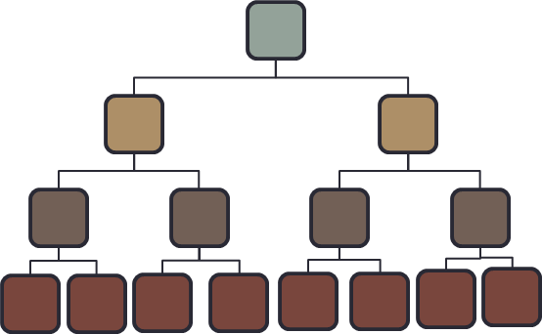
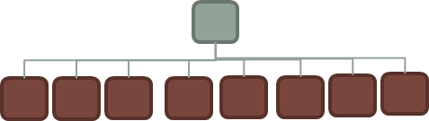
Design Variables
Shape of Organizations
Span of control
Number of individuals that report to each manager
What is the ideal span of control?
Shape: Flat vs. Tall
Flat: large units and wide spans of control
Tall: small units and narrow spans of control

Slide 19


Slide 20
Design Variables
Shape of Organizations
Span of control (from bureaucracy)
Number of individuals that report to each manager
What is the ideal span of control?
Shape: Flat vs. Tall
Flat: large units and wide spans of control
Tall: small units and narrow spans of control

Slide 21
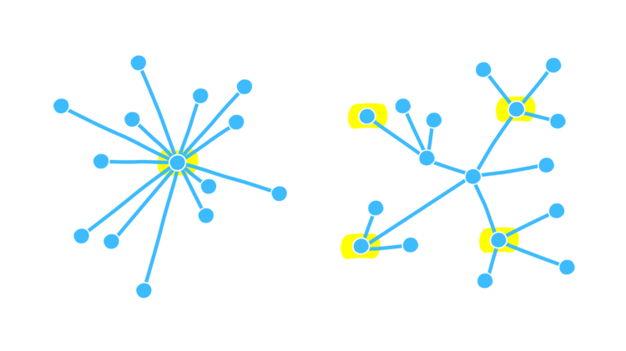
Design Variables
Decision making
Centralized vs Decentralized.

Slide 22
Design Variables
Decision making
Centralized vs Decentralized.

Slide 23
Design Variables
Decision making
More Centralized: Decisions are made higher up in the hierarchy.
Decentralized: More delegation of decisions.
Issues
If highly centralized
Overload (You expect a small number of decision makers to make all decisions)
Loss of flexibility (You have to wait around waiting for your supervisor’s supervisor to make a decision)
If highly decentralized:
Expertise vs. consistency/control (Experts can flourish, but consistency and control are reduced)
Professionals automatically decentralize to some degree.

Slide 24
Design Variables
Grouping of Tasks
Grouping of Tasks: Basic Structural Configurations (part of Chapter 6 in the textbook)
Three basic structural configurations
Functional
Divisional
Matrix
“idealistic” configurations
Large organizations may contain 2 or more different configurations embedded in the overall structure
Transition from functional to matrix or divisional configurations is (usually) a function of growing organizational size

Slide 25
Design Variables
Functional Structure
Organization pools human and material resources across different work flows
Group by knowledge, skill, work process, or work function

Slide 26
Design Variables
Functional Structure
President
VP Eng
VP Manufacturing
VP Sales
Director R/D
Director Eng
Production Supervisors
Director Marketing
Director
Sales
Scientists
Engineers
Operators
Marketers
Salespeople

Slide 27
Functional Structure
Advantages
Economies of scale
Efficiently use resources
Technical excellence, specialization, knowledgeable supervision
Evaluation of performance
Better communication & coordination within unit

Slide 28
Functional Structure
Disadvantages
Functional goals outweigh broader/product goals
Leads to client dissatisfaction
Loss of flexibility – more bureaucratic
Loss of mechanism for coordinating work-flow
Conflict between units
Good for:
Smaller organizations (or divisions of larger ones)
Stable environments

Slide 29
Divisional
Divisional (Output, Product-Based, Geographic) Structure.
Each unit performs all the functions for a given set of products, services, clients or places.
Geographic structure is a special case.

Slide 30
Divisional
President
VP MP3 Players
VP Alarm Clocks
VP Headphones
Director R/D
Director Eng
Production Supervisor
Director Marketing
Director
Sales
Scientists
Engineers
Operators
Marketers
Salespeople

Slide 31
Divisional Structure
Advantages
Cross-functional communication and coordination
Focus on client’s needs
Broadly trained managers
Flexible (less bureaucratic)
Easy to add or remove units
Good workflow coordination

Slide 32
Divisional Structure
Disadvantages
Less specialization (technical expertise)
Wasteful of resources – resource duplication
Reduced communication amongst specialists
Good for:
Large organizations and unstable environments

Slide 33
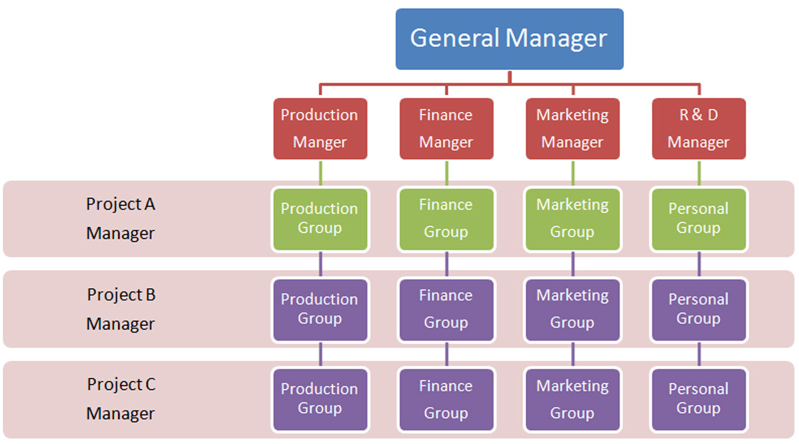
Matrix Structure
Group by both function and product.

Slide 34
Matrix Structure
Advantages
Best of both worlds
Adaptive
Efficient use of resources
Home base for specialists

Slide 35
Divisional Structure
Disadvantages
Worst of both worlds, role confusion, effort to coordinate
Conflict between functional and project units
Cost of administration & communication.
Good for:
Unstable environment
When output goals and functional goals are of equal importance (e.g. UW)

